Slide 1
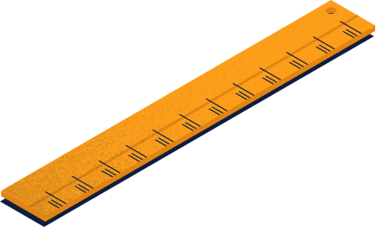





DSA-3
pROJEct

Slide 2




Intelligent Student Record Search System.
TEAM MEMBERS:
2520030126-Siri
2520030230-Hemanth
2520030091-Rupesh

Slide 3
Project ABSTRACT
Educational institutions manage thousands of student records containing names, roll numbers, departments, courses, marks, attendance, achievements, and project details. As the database grows, manually searching for records becomes slow and inefficient.
The Intelligent Student Record Search System provides an efficient repository for storing and retrieving student information. Initially, it supports record management and keyword-based searching. By applying concepts from Advanced Data Structures and Algorithms, the system can be extended with fuzzy search, similarity matching, indexing, ranking, and auto-complete, enabling faster and more accurate search results.

Slide 4
Problem Statement
Existing Problems
Manual searching is time-consuming.
Large datasets reduce search efficiency.
Exact keyword searches may fail when spelling errors occur.
Difficulty in finding similar student records.
Traditional searching cannot provide intelligent suggestions or ranking.
Need for the System
Develop a smart record management system that applies advanced algorithmic techniques to improve search speed, accuracy, and scalability.

Slide 5
proposed functionalities
Basic Features
Add, update, and delete student records.
Store student information in a repository.
Search records using Roll Number, Name, Department, or Course.
Keyword-based search.
Advanced DSA Features (Module-1 Concepts)
Pattern Search – Fast keyword searching using string algorithms.
Fuzzy Search – Find records despite spelling mistakes using edit distance.
Similarity Matching – Identify similar student records.
Indexing – Faster retrieval of records.
Ranking – Display the most relevant search results first.
Auto-complete – Suggest names or roll numbers while typing.

Slide 6
tools & technologies
Programming Language
Java
Data Structures & Algorithms
Arrays
Linked Lists
Hash Tables
Trees
String Algorithms
Dynamic Programming
Indexing Techniques
Database
MySQL / SQLite
Development Tools
Visual Studio Code / IntelliJ IDEA
Git & GitHub

Slide 7
expected outcome.
After completing the project, the system will:
Store and manage student records efficiently.
Provide fast keyword-based searching.
Improve search accuracy using fuzzy search and similarity matching.
Reduce manual effort in retrieving student information.
Demonstrate the practical use of advanced DSA concepts such as string algorithms, dynamic programming, and indexing.
Provide a scalable foundation for future intelligent search systems with ranking and auto-complete features.

Slide 8
Thank You

